Slide 1
Chapter 1
What is Statistics?
© McGraw Hill LLC. All rights reserved. No reproduction or distribution without the prior written consent of McGraw Hill LLC.

Slide 2
Learning Objectives
L O1-1 Explain why knowledge of statistics is important.
L O1-2 Define statistics and provide an example of how statistics is applied.
L O1-3 Differentiate between descriptive and inferential statistics.
L O1-4 Classify variables as qualitative or quantitative, and discrete or continuous.
L O1-5 Distinguish between nominal, ordinal, interval, and ratio levels of measurement.
L O1-6 List the values associated with the practice of statistics.

Slide 3
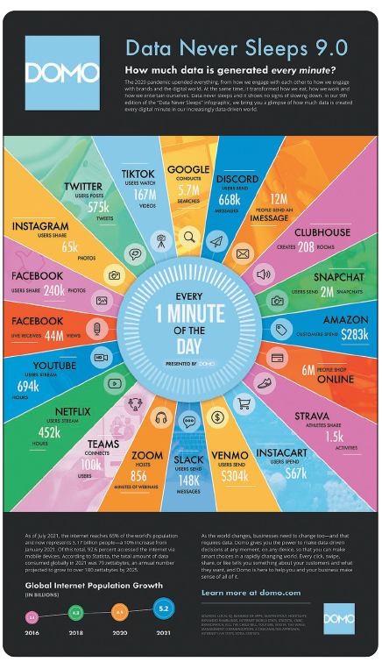
Why Study Statistics
Data are collected everywhere and require statistical knowledge to make the information useful.
Statistics is used to make valid comparisons and to predict the outcomes of decisions.
Statistical knowledge is useful in any career.
Access the text alternative for slide images.

Slide 4
What is Meant by Statistics
Statistics The science of collecting, organizing, presenting, analyzing, and interpreting data to assist in making more effective decisions.
Example: The inflation rate for the calendar year was 5.4%.
  We could compare this year’s inflation rate to past observations of inflation.
  Is it higher, lower, or about the same?
  Is there a trend of increasing or decreasing inflation?
  Is there a relationship between interest rates and government bonds?

Slide 5
Types of Statistics 1
There are two types of statistics: descriptive and inferential.
Descriptive statistics can be used to organize data into a meaningful form.
You can summarize data and provide information that is easy to understand.
Descriptive Statistics Methods of organizing, summarizing, and presenting data in an informative way.
  Example: There are a total of 46,837 miles of interstate highways in the U.S.
  The interstate system represents 1% of the nation’s roads but carries more than 20% of the traffic.
  Texas has the most interstate highways and Alaska doesn’t have any.

Slide 6
Types of Statistics 2
Inferential statistics can be used to estimate properties of a population.
You can make decisions based on a limited set of data.
Inferential Statistics The methods used to estimate a property of a population on the basis of a sample.
Example: In 2021, a vaccination for COVID-19 was freely available.
  To determine who did not get the vaccine, random samples of people were selected and surveyed.
  What is the proportion of people that did not get the vaccine?

Slide 7
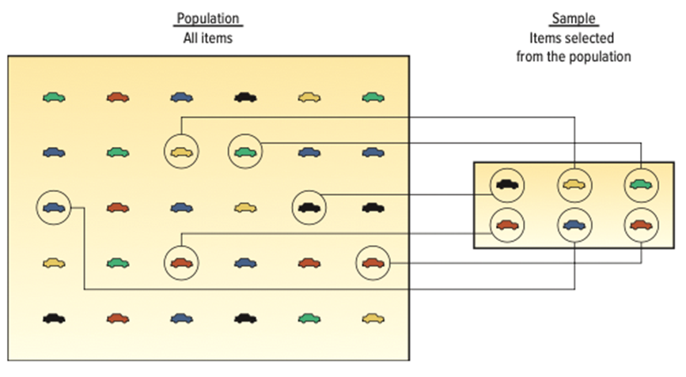
Types of Statistics 3
Population The entire set of individuals or objects of interest or the measurements obtained from all individuals or objects of interest.
Sample A portion or part of the population of interest.
Access the text alternative for slide images.

Slide 8
Types of Variables 1
There are two basic types of variables.
Qualitative Variable An object or individual is observed and recorded as a non-numeric characteristic or attribute.
Examples: Gender, state of birth, eye color.
Quantitative Variable A variable that is reported numerically.
Examples: Balance in your checking account, the life of a car battery, the number of people employed by a company.

Slide 9
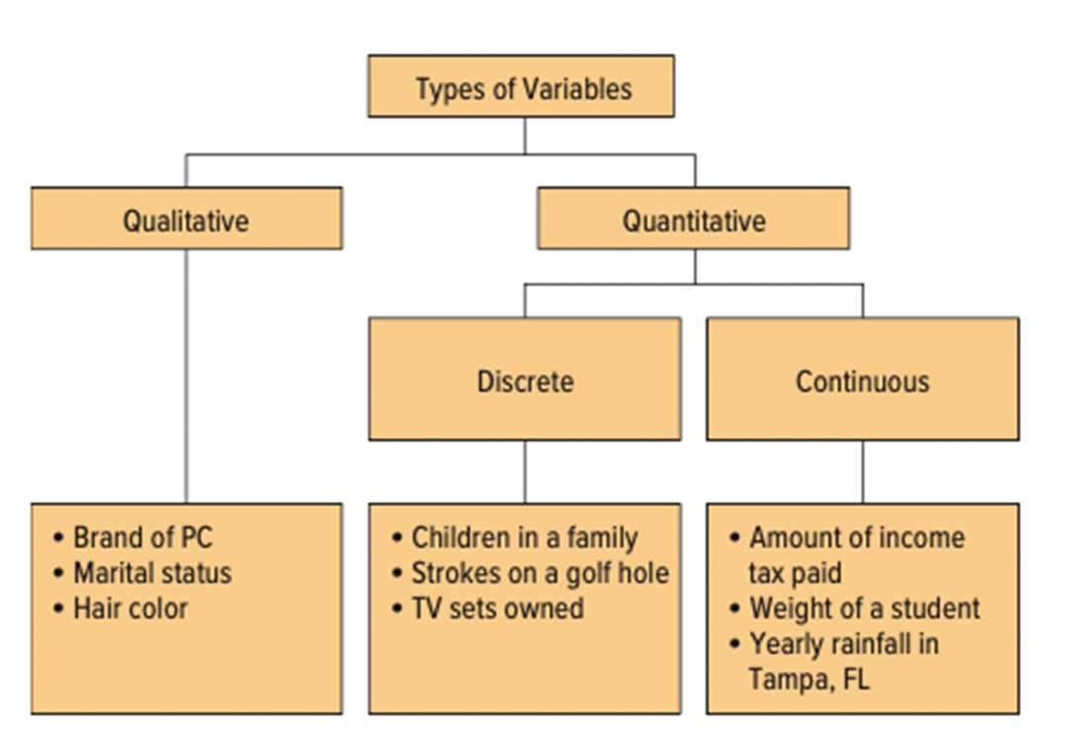
Types of Variables 2
Access the text alternative for slide images.

Slide 10
Types of Variables 3
Quantitative variables can be discrete or continuous.
Discrete variables are typically the result of counting.
  Values have “gaps” between the values.
  Examples: The number of bedrooms in a house (1, 2, 3, 4, etcetera), the number of students in a statistics course (326, 421, etcetera).
Continuous variables are usually the result of measuring something.
  Can assume any value within a specific range.
  Examples: Duration of flights from Orlando to San Diego (5.25 hours), grade point average (3.258).

Slide 11
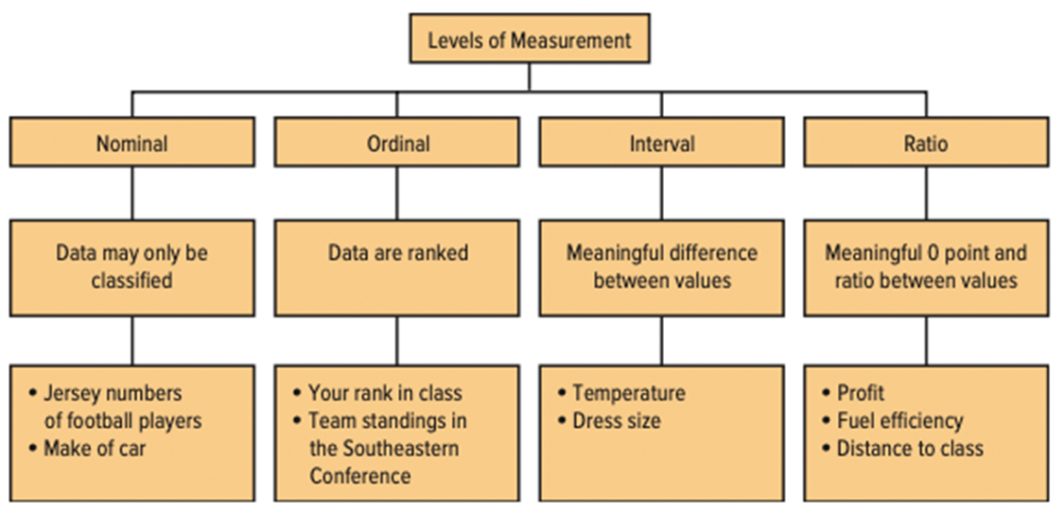
Levels of Measurement 1
There are four levels of measurement.
The level of measurement determines the type of statistical analysis that can be performed.
Access the text alternative for slide images.

Slide 12
Levels of Measurement 2
Nominal is the lowest level of measurement.
Nominal Level Of Measurement Data recorded at the nominal level of measurement is represented as labels or names. They have no order. They can only be classified and counted.
Examples: Classifying M&M candies by color, identifying students at a football game by gender.

Slide 13
Levels of Measurement 3
The next higher level of measurement is the ordinal level.
Ordinal Level Of Measurement Data recorded at the ordinal level of measurement is based on a relative ranking or rating of items based on a defined attribute or qualitative variable. Variables based on this level of measurement are only ranked and counted.
Examples: The list of top ten states for best business climate, student ratings of professors.

Slide 14
Levels of Measurement 4
The next higher level of measurement is the interval level.
This data has all the characteristics of ordinal level data.
Plus the differences between the values are meaningful.
There is no natural 0 point.
Interval Level of Measurement For data recorded at the interval level of measurement, the interval or the distance between values is meaningful. The interval level of measurement is based on a scale with a known unit of measurement.
Examples: The Fahrenheit temperature scale, dress sizes.

Slide 15
Levels of Measurement 5
The highest level of measurement is the ratio level.
The data has all the characteristics of the interval scale and ratios between numbers are meaningful.
The 0 point represents the absence of the characteristic.
Ratio Level of Measurement Data recorded at the ratio level of measurement are based on a scale with a known unit of measurement and a meaningful interpretation of zero on the scale.
Examples: Wages, changes in stock prices, and height.

Slide 16
Ethics and Statistics
Practice statistics with integrity and honesty when collecting, organizing, summarizing, analyzing, and interpreting numerical information.
Maintain an independent and principled point of view when analyzing and reporting findings and results.
Question reports that are based on data that:
Do not fairly represent the population.
Do not include all relevant statistics.
Introduces bias in an attempt to mislead or misrepresent.

Slide 17
Chapter 1 Practice Problems

Slide 18
Question 1
L O1-5
What is the level of measurement for each of the following variables?
a. Student I Q ratings.
b. Distance students travel to class.
c. The jersey numbers of a sorority soccer team.
d. A student’s state of birth.
e. A student’s academic class – that is, freshman, sophomore, junior, or senior.
f. Number of hours students study per week.
Notes:
a. Interval
b. Ratio
c. Nominal
d. Nominal
e. Ordinal
f. Ratio

Slide 19
Question 13
L O1-4,5
For each of the following, determine whether the variable is continuous or discrete, quantitative or qualitative, and level of measurement.
a. Salary.
b. Gender.
c. Sales volume of MP3 players.
d. Soft drink preference.
e. Temperature.
f. S A T scores.
g. Student rank in class.
h. Rating of a finance professor.
I. Number of home video screens.
Notes:
Discrete Continuous
Qualitative b. Gender
c. Soft drink preference
g. Student rank in class
h. Rating of a finance professor
Quantitative c. Sales volume of MPS players a. Salary
f. SAT Scores e. Temperature
i. Number of home computers

Slide 20
End of Main Content
© McGraw Hill LLC. All rights reserved. No reproduction or distribution without the prior written consent of McGraw Hill LLC.

